Slide 1
You are the vine, we are the branches
Words & Music: Danny Daniels & Randy Rigby

Slide 2
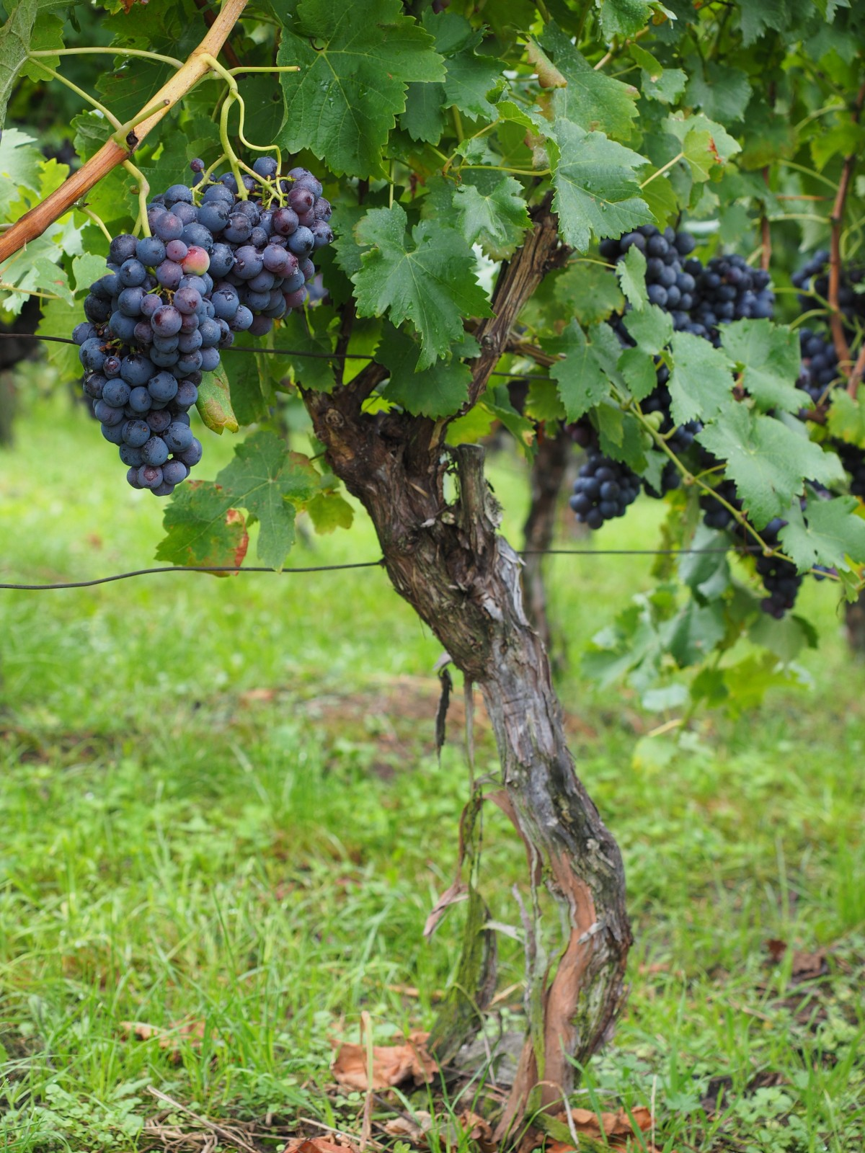
you are the vine 你是葡萄樹
we are the branches 我 們是枝子
keep us abiding in you 保守我們在 你裡面
(X2)
then we’ll grow in your love 我們在你 愛裡成長
and we’ll go in your name 我們奉你 名出去
that the world will surely know 世人就 必然知道
that you have power to heal and to save
你有能力 醫治 與拯救

