Slide 1
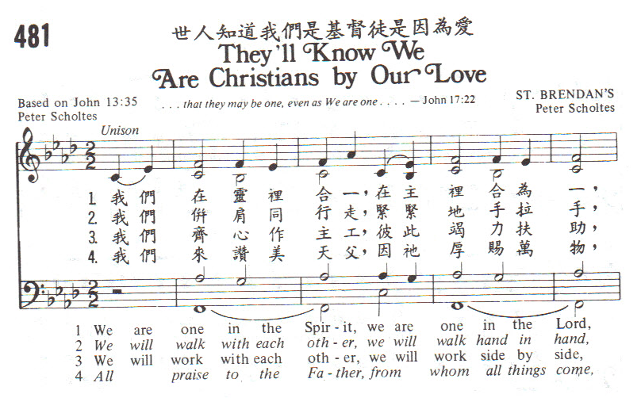
They’ll know We are Christians by our Love - 1

Slide 2
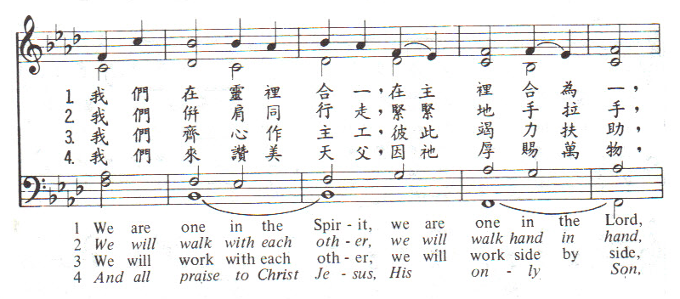
They’ll know We are Christians by our Love - 2

Slide 3
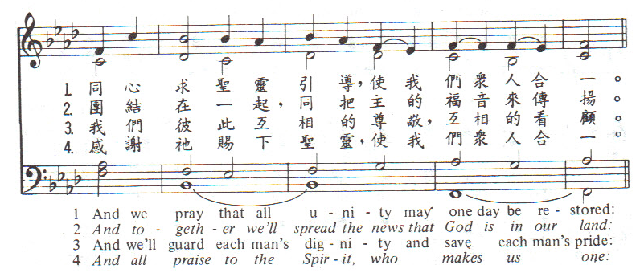
They’ll know We are Christians by our Love - 3

Slide 4
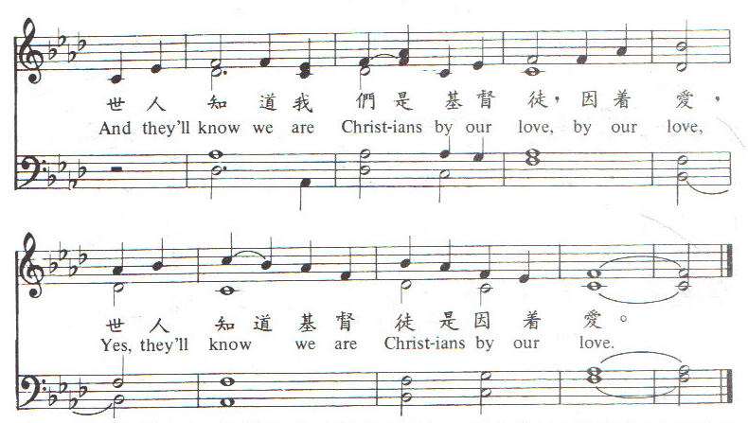
They’ll know We are Christians by our Love - 4

Slide 6
In Moments Like These美好時辰- 1
In moments like these, I sing out a song.
這美好時辰,我願高聲唱,
I sing out a love song to Jesus.
我願高聲唱我愛耶穌.
In moments like these, I lift up my hand,
這美好時辰,我向神舉手,
I lift up my hands to the Lord.
我向神舉手讚美主.

Slide 7
In Moments Like These美好時辰- 2
Singing I love You, Lord,
高唱我愛你,主,
singing I love You, Lord,
高唱我愛你,主,
singing I love You, Lord, I love You.
高唱我愛你,主,我愛你.

Slide 9
His Eye is on the Sparrow祂看顧麻雀- 1
為何傷心又怨歎,為何終日煩愁, Why should I feel discouraged, Why should the shadows come, 為何心內覺孤單,甚至欲脫塵環,
Why should my heart feel lonely, And long for Heav'n and home, 耶穌是我的良友,萬福賜我享受.
When Jesus is my portion? A constant Friend is He. 祂既看顧小麻雀,深知必看顧我.
His eye is on the sparrow, And I know He watches me.

Slide 10
His Eye is on the Sparrow祂看顧麻雀- 2
祂既看顧小麻雀,深知必看顧我.
His eye is on the sparrow, And I know He watches me. 我唱因我得自由,我唱因我快樂.
I sing because I‘m happy, I sing because I'm free. 祂既看顧小麻雀,深知必看顧我.
His eye is on the sparrow, And I know He watches me.

Slide 12
Psalm 103 詩篇第103篇 - 1
Praise the Lord, Oh my soul,
我的心你要稱頌耶和華,
Forget not all His blessings,
不可忘記祂的恩惠.
He forgives all your faults and sins,
祂赦免你一切過犯罪孽,
And heals all your diseases.
醫治你疾病復原.

Slide 13
Psalm 103 詩篇第103篇 - 2
Praise the Lord, Oh my soul,
我的心你要稱頌耶和華,
Forget not all His blessings,
不可忘記祂的恩惠.
He crowns you with love and compassion,
祂以仁愛慈悲為你冠冕,
He works justice for the oppressed.
為受屈的人伸冤.

Slide 14
Psalm 103 詩篇第103篇 - 3
Far as heav’ns are above the earth,
天離地有何等的高,
so great is His mercy and love,
祂的慈愛也何等的深;
Far as east is from the west,
東離西有多麼的遠,
so far has he removed my transgressions,
祂使我的過犯也離我多遠.

Slide 15
Psalm 103 詩篇第103篇 - 4
The Lord, compassionate and gracious,
耶和華有憐憫的愛,
abounds in mercy and love,
且有豐盛無盡的恩典,
From e’rlasting to e’rlasting
從亙古直到永遠,
The Lord, He is my God.
耶和華, 祂是我的神.

Slide 17
O Holy Night 噢!聖善夜- 1
O Holy Night! The stars are brightly shining,
噢!聖善夜 星星都閃耀輝煌 It is the night of the dear Saviour's birth.
就在這裡 親愛主已降臨 Long lay the world in sin and error pining.
世人沉淪 罪惡及哀傷滿盈 Till He appeared and the Spirit felt its worth.
直到祂來 心靈終得安慰
A thrill of hope the weary world rejoices,
疲備的人 振奮精神迎盼望

Slide 18
O Holy Night 噢!聖善夜- 2
For yonder breaks a new and glorious morn.
從主而來 榮耀新清晨 Fall on your knees! Oh, hear the angel voices!
跪拜主前 噢!聽天使在歌唱 O night divine, the night when Christ was born;
噢!聖善夜 這夜 基督降臨 O night, O Holy Night , O night divine!
聖夜 聖善夜 基督降臨 O night, O Holy Night , O night divine!
聖夜 聖善夜 基督降臨

Slide 19
O Holy Night 噢!聖善夜- 3
O Holy light of faith serenely beaming, With glowing hearts by His cradle we stand. So led by light of a star sweetly gleaming, Here came the wise men from Orient land. The King of kings lay thus in lowly manger; In all our trials born to be our friend. He knows our need, our weakness is no stranger, Behold your King! Before him lowly bend! Behold your King! Before him lowly bend!

Slide 21
It came upon the midnight clear - 1
It came upon the midnight clear,
That glorious song of old,
From angels bending near the earth,
To touch their harps of gold;
“Peace on the earth, good will to men,
From Heaven’s all gracious King.”
The world in solemn stillness lay,
To hear the angels sing.

Slide 22
It came upon the midnight clear - 2
Still through the cloven skies they come
With peaceful wings unfurled,
And still their heavenly music floats
O’er all the weary world;
Above its sad and lowly plains,
They bend on hovering wing,
And ever over its Babel sounds
The blessèd angels sing.

Slide 23
It came upon the midnight clear - 3
Yet with the woes of sin and strife
The world has suffered long;
Beneath the angel strain have rolled
Two thousand years of wrong;
And man, at war with man, hears not
The love-song which they bring;
O hush the noise, ye men of strife
And hear the angels sing.

Slide 24
It came upon the midnight clear - 4
And ye, beneath life’s crushing load,
Whose forms are bending low,
Who toil along the climbing way
With painful steps and slow,
Look now! for glad and golden hours
Come swiftly on the wing.
O rest beside the weary road,
And hear the angels sing!

Slide 25
It came upon the midnight clear - 5
For lo! the days are hastening on,
By prophet-bards foretold,
When with the ever circling years
Comes round the age of gold;
When peace shall over all the earth
Its ancient splendors fling,
And the whole world send back the song
Which now the angels sing.

